Slide 1

The Bakery Serverless Web Application
Presented by: Raul Rodriguez

Slide 2


Introduction
With the increasing popularity of serverless computing, I was intrigued by the idea of building a web application that could leverage the benefits of serverless architecture, such as scalability, cost-effectiveness, and ease of deployment. By choosing a bakery theme, I aimed to create a fun and engaging online platform that could provide an interactive experience for both baking enthusiasts and customers alike. Through this project, I wanted to explore the capabilities of AWS services such as AWS Lambda, Amazon Amplify, and Amazon DynamoDB, and create a unique web application that could showcase the new skills I learned this semester.
Cookie shop

Slide 3

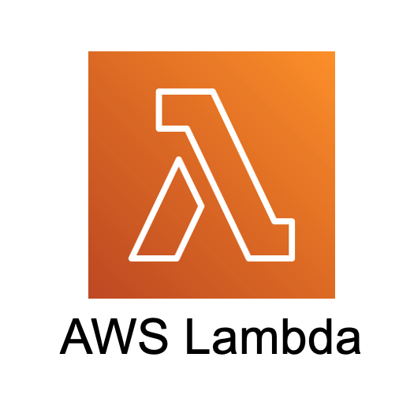





List Of Services Used
01
02
03
AWS Lambda
API Gateway
AWS Amplify
04
05
AWS IAM
AWS DynamoDB

Slide 4
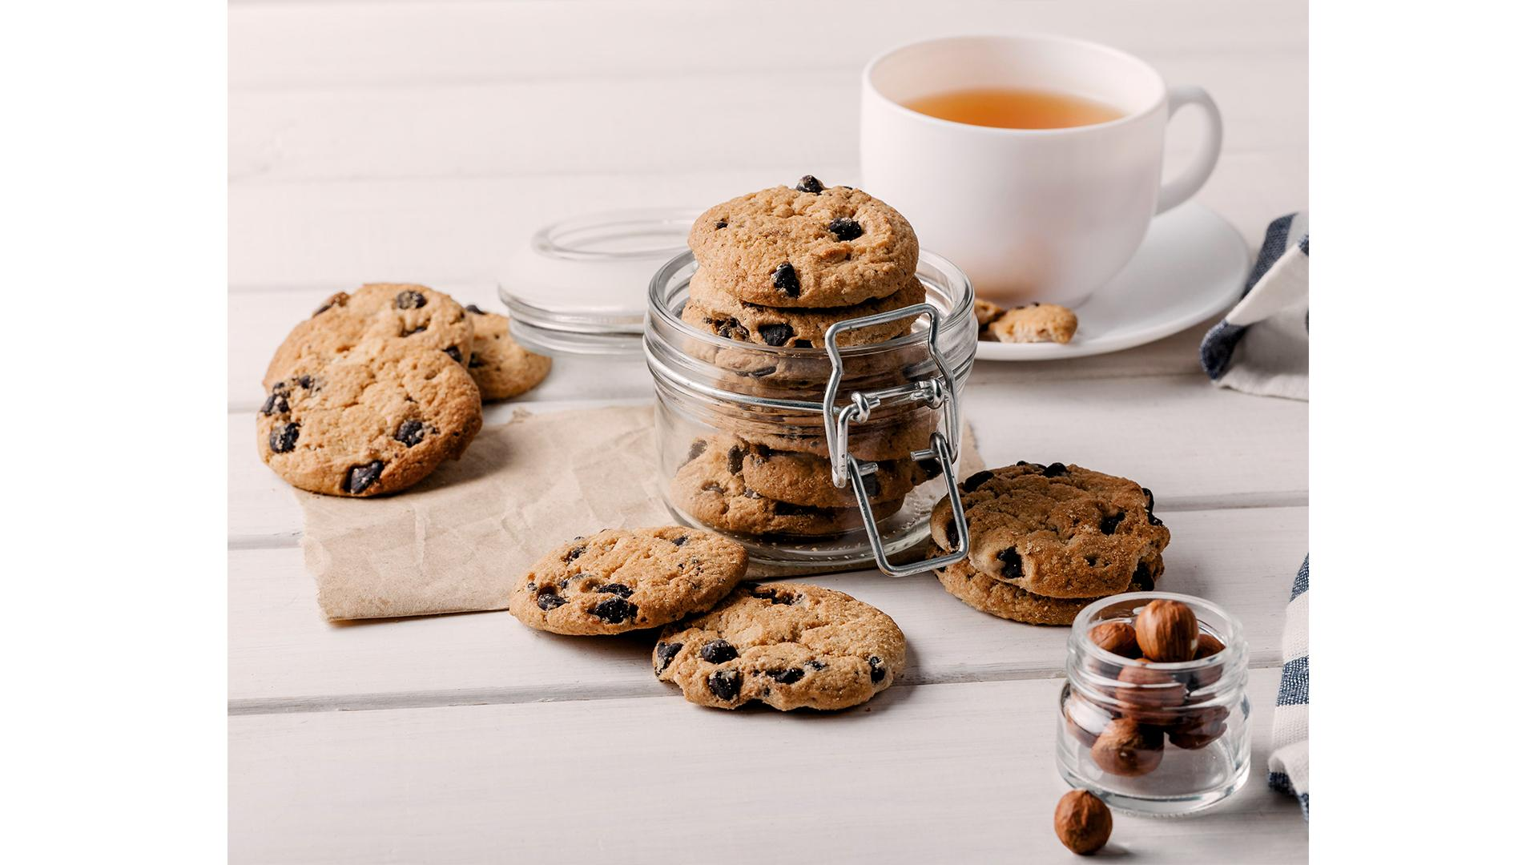
How Is It All Connected?
Amplify
User
DynamoDB
API Gateway
IAM

Slide 5

SCREENSHOTS
SOLUTION

Slide 6
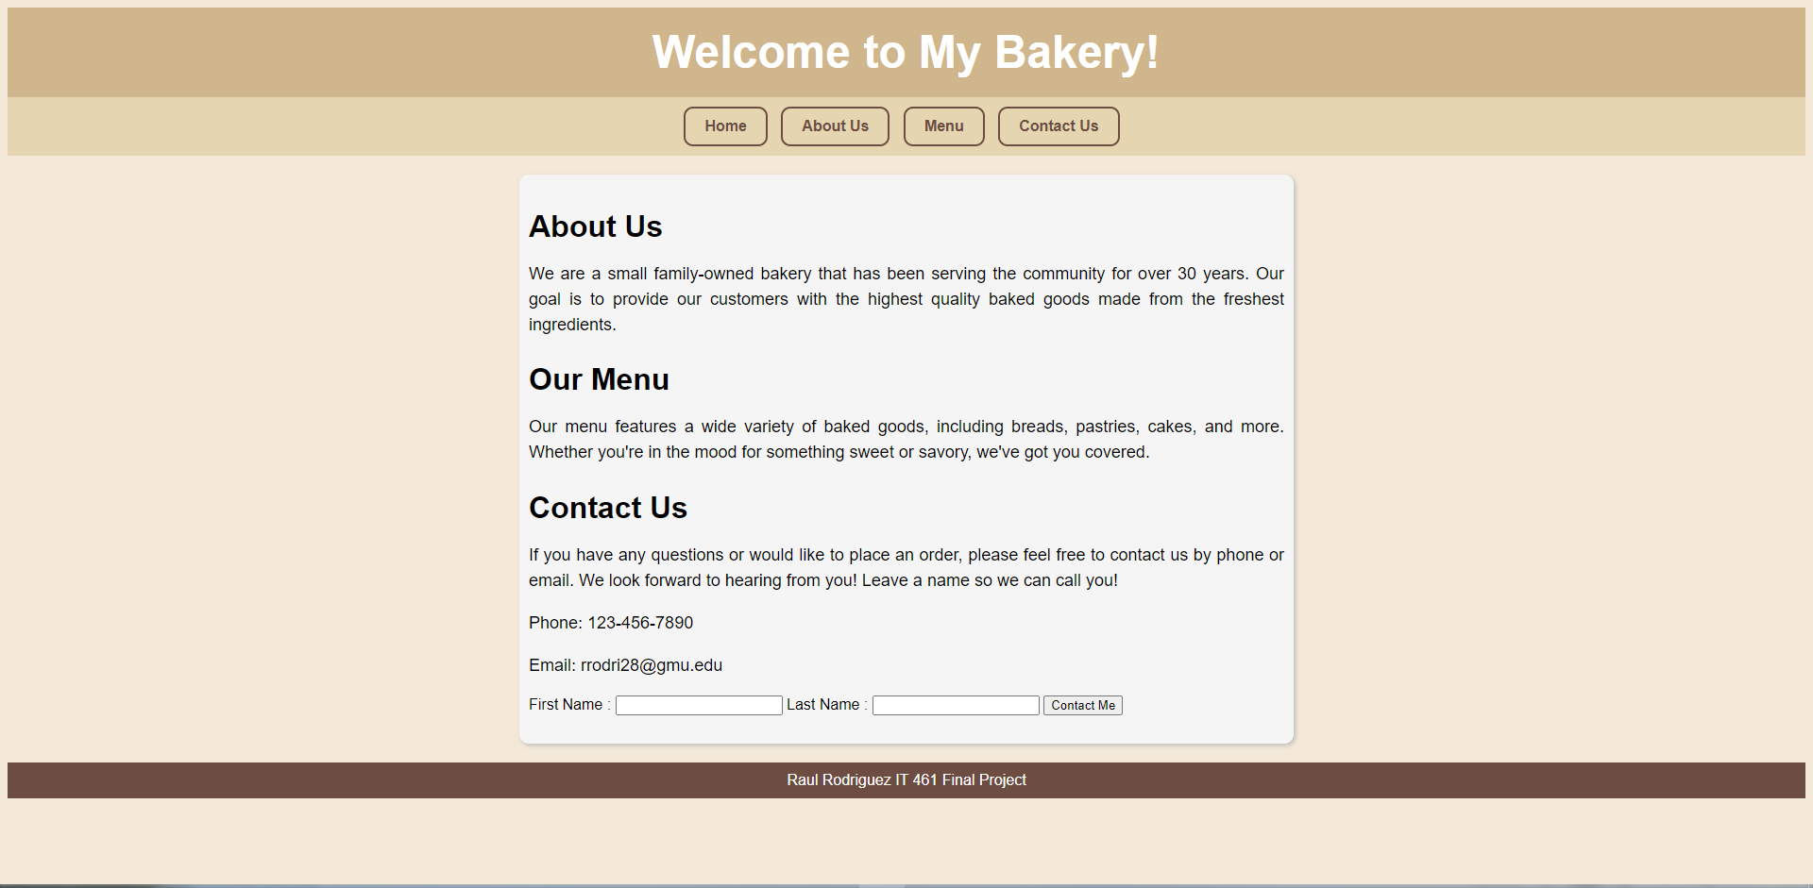

Slide 7
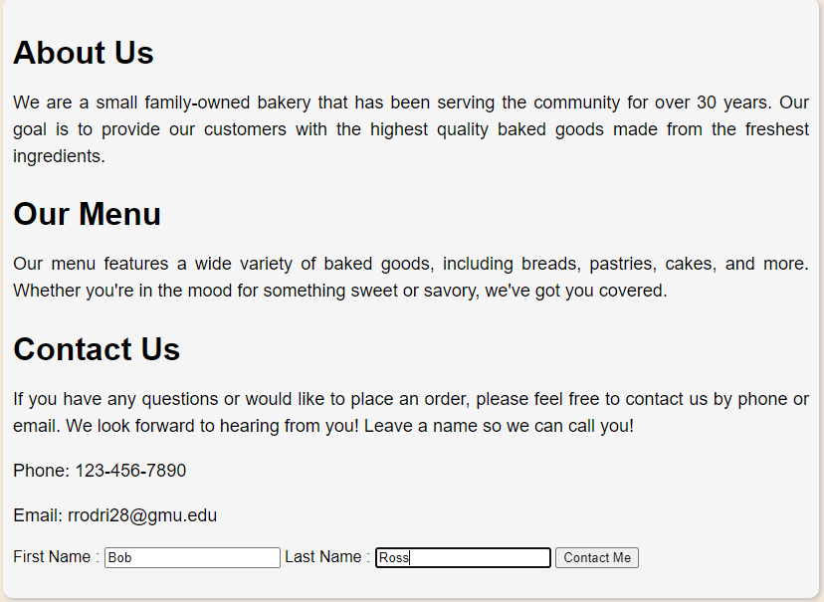

Slide 8
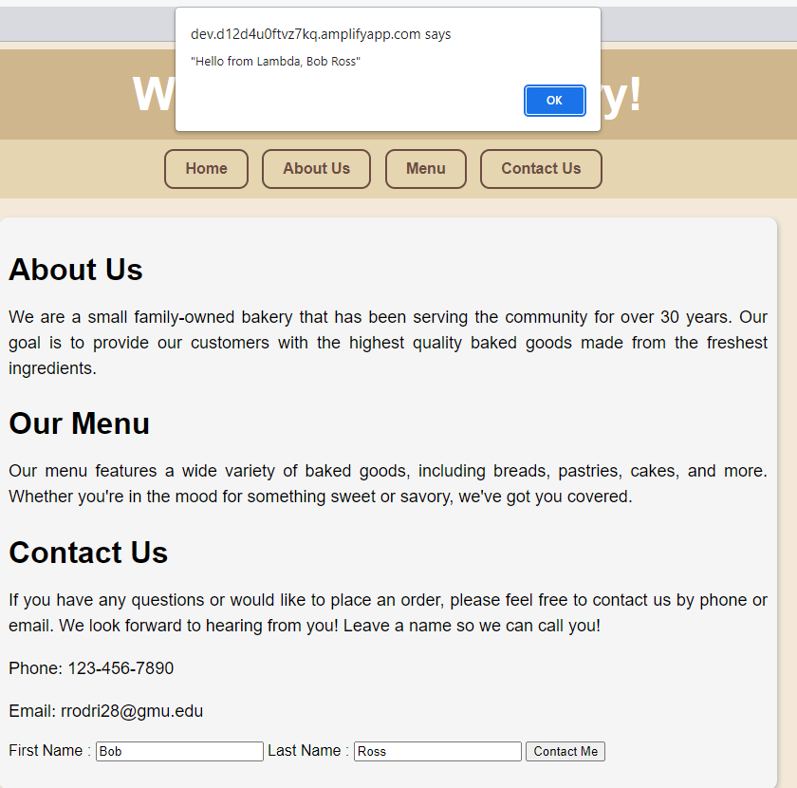

Slide 9
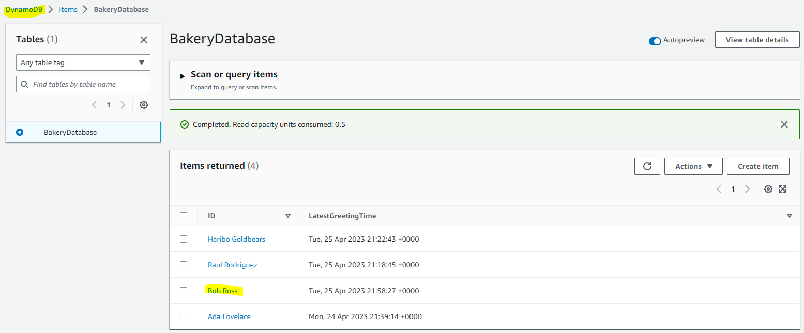

Slide 10
Resources
North, F. (1998). Getting started. Amazon. Retrieved April 25, 2023, from https://aws.amazon.com/getting-started/hands-on/build-web-app-s3-lambda-api-gateway-dynamodb/

